Slide 1
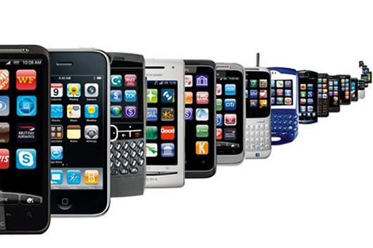
TalkingData Mobile
User Demographics Prediction
Huy Doan,
Ravindra Manjunatha,
Colin Maxfield,
Saharsh Oza,
Chin Wei Yeap
Vivek Khetan
May 4, 2017

Slide 2
Topics
Introduction
Data Preprocessing and Challenges
Model Selection
Results
Future Work
Lessons learnt

Slide 3
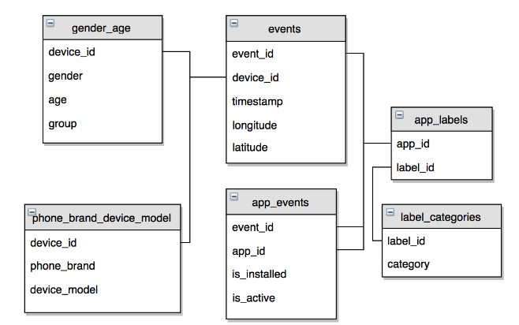
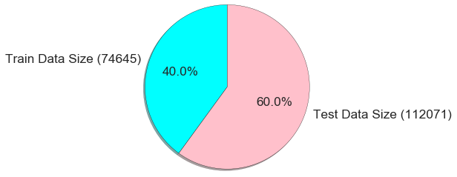
Dataset
Relational Database
Test/Train Split
Big data big numbers
130 phone models
3.2 Million Events
32 Million App Events

Slide 4

Problem Statement
What to predict? Given device info and app activity, predict class probabilities of gender and age split across 12 groups.
Evaluation Metric
Baseline to beat Probability of each class = 1/12 Log loss cost of a random guess = 2.48

Slide 5
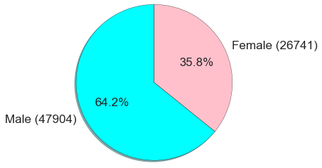
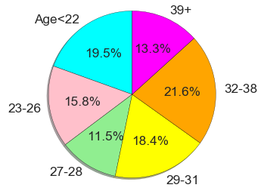
Priors
Gender prior
Age prior

Slide 6
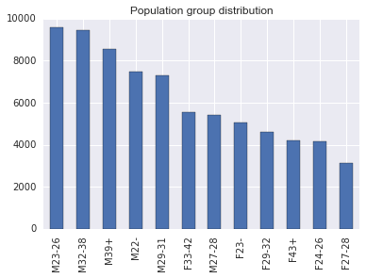
Priors
Class imbalance:
Priors skewed towards male versus female
F27-28 has fewest samples.

Slide 7
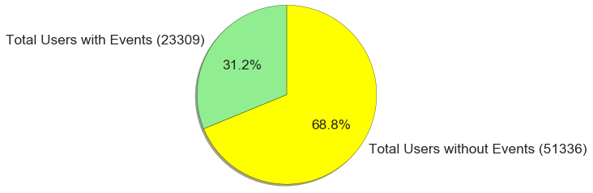
Dataset Challenges
Insufficient features, need derived features
70% users have no events
Missing location data, discard
Bias on high-activity app users
Age/gender neutral apps

Slide 8
Preprocessing, Feature Selection
One hot coding for app label category, remove duplicate/NA
Total apps installed/active per user
Total apps per label category
Total events by hour, label category, location
Mean, variance of app activity time, location
Save preprocessed data frame in csv file for future reuse
Forward Feature Selection (Faster)

Slide 9
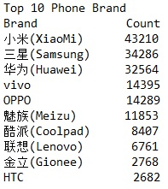
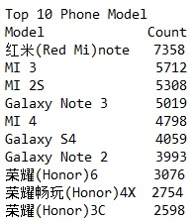
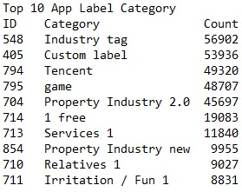
Features
Top 2 phone brands (XiaoMi, Samsung) covers top 7 phone models (MI ***, Galaxy ***)
Top 10 app labels are mostly for productivity (Industry tag, Services), entertainment (Game, Fun), social (Relatives), and hot Chinese property/housing market (Property Industry 2.0 and New)

Slide 10
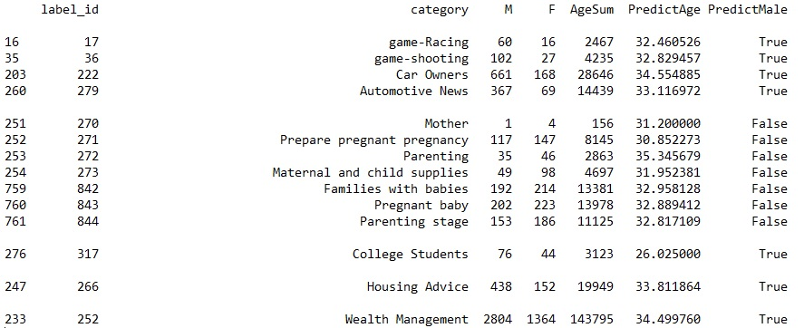
Derived Features
PredictAge = AgeSum / (M + F)
PredictMale = True if Male > Female

Slide 11
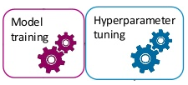
Model Selection
Use a wide variety of models to compare strengths:
LDA and QDA
SVM, kNN, and Logistic Regression
Ensemble models: xgboost, Adaboost, random forest

Slide 12
Expected Behavior
Model the likelihood:
Data is highly non-gaussian. Hence, models that expect gaussian distribution will not perform as well without proper transformation. Look for other distributions to represent data.
Model the posterior:
Data is highly non-linear. So, we expect SVM with RBF kernel and kNN to do well.

Slide 13
Hyperparameters Tuning
Stratified Cross Validation
Grid Search CV, Randomized Search CV
Early Stopping Convergence
Stacking many models using auto sklearn

Slide 14
Initial models considered
Random Forest - Easy to interpret and get feature importance. Log loss 2.36.
Extra Tree classifier - RF without bootstrapping. Sometimes does well in Kaggle competition compared to RF. 2.36
Ada and XG boost - Popular in Kaggle competition. 2.38 and 2.34.
Eggensperger et al have showed, tree-based models have been shown to be more successful in high-dimensional,structured, and partly discrete problems.[3]

Slide 15
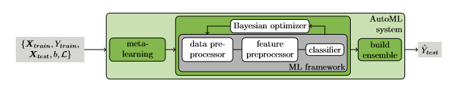
Auto sklearn(Feurer et al[2])
Bayesian optimisation method for optimizing the hyper parameters for machine learning models.
Contains 15 ensemble models, 14 feature pre processing techniques and 4 data pre processing techniques.
Less documentation.
Reading through code and github issue, we ran our code on google cloud in SMAC mode 56 CPU hours to get 2.31 log loss.
It gave us a good intuition where to improve.

Slide 16
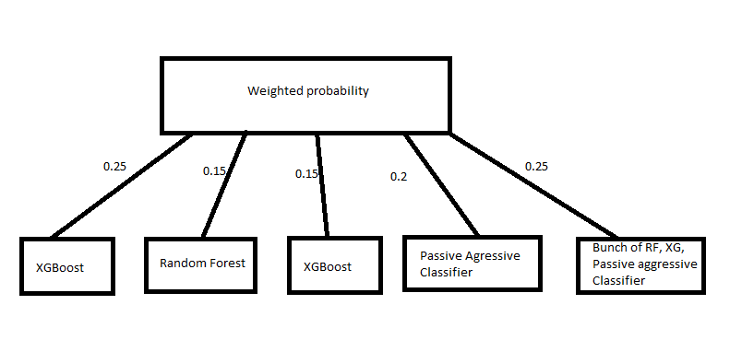
Stacked Model 1- log loss 2.31

Slide 17
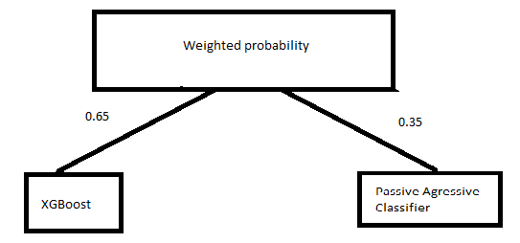
Stacked Model 2 - log loss 2.30
Few things we did notice that including SVM, LDA made log loss higher 2.36.
We already knew this from our individual learner experiment.
Auto sklearn still considered them as competitive learner, sometime ranking higher than gradient boosted trees.

Slide 18
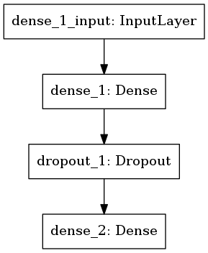
Feature processing + XGBoost = 2.28
XGBoost was top among the competitive learner, hence reducing the feature space was our strategy. Also added temporal and location features.
Reduced our features from 21,035 to 1000 features using sklearn feature selection package by performing chi2 test + XGBoost = 2.28.
We tried PCA, didn’t work in terms of performance.
Same time applying 21,035 feature and simple logistic regression scored 2.26.
We tried, ensemble model XGBoost + Passive aggressive classifier + Logistic Regression got 2.27.
Since Logistic regression performed well, we tried simple feed forward neural network with log loss 2.24 (1,077,012 trainable params).

Slide 19
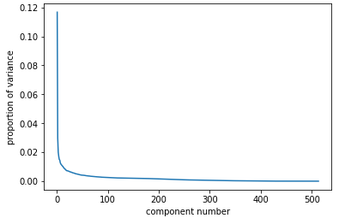
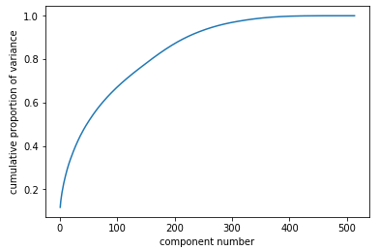
PCA
Scree plot
Cumulative Proportional Variance plot

Slide 20
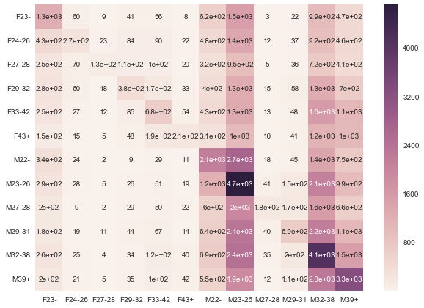
Results - Confusion matrix

Slide 21
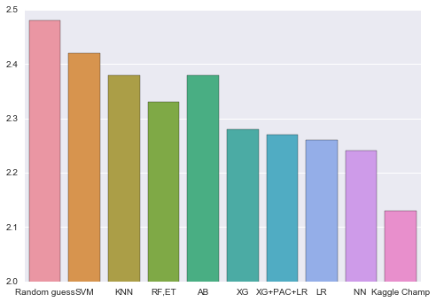
Results
Method | Log loss
Random guess | 2.48
SVM | 2.42
KNN | 2.39
Random Forest | 2.33
Adaboost | 2.38
Xgboost | 2.28
XGB + PAC + LR | 2.27
Logistic Regression | 2.26
Neural Network | 2.24
Kaggle Champion | 2.13

Slide 22
Data Leakage
Best score is 2.13, tuning the model by data leakage. Many score after 2.23 and 2.22 started doing data leakage tuning.
Data leakage means:
Leaking test data into the training data.
Leaking the correct prediction or ground truth into the test data.
Leaking of information from the future into the past.
Data leakage is bad, because you do over fitting on test data, such model do poorly on future data.
It’s one of kaggle competition where winners weren’t congratulated.

Slide 23
Lessons Learned
Preprocessing of data will take lot of your time.
Sparse matrix is your friend and enemy.
Many library need sparse to dense conversion if not careful will lead to memory error. Keras need batch generator for training and testing when sparse matrix used.
Auto sklearn is good tool, but one need to use cautiously.
Creative feature engineering will win you competition, we didn’t include this feature in our model. 5th place had below features, in their model
Min_appevent_maxapp_active, min_appevent_range_appactive
Model stacking is an art. Bag the many ensemble classifier and add Logistic regression and deep neural networks at the end.
Notes:
Sparse matrix: PCA and Keras library need explicit code modification.

Slide 24
Future Work and Conclusion
Add TF-IDF features on label, phone and brand words and add interaction features between events.
Adding dropout to input layer reported higher accuracy for neural networks.
Build stack or weight model for ensemble models with neural networks.
Building two stage models, one for gender classification. Input the gender probability as a feature to second model to get final 12 class probability.
Notes:
Term frequency - Inverse Document Frequency
Interaction between features
Neural network:

Slide 25

Q&A
Image Source: http://www.clipartkid.com/question-and-answer-cliparts/

Slide 26
Reference
TalkingData dataset, https://www.kaggle.com/c/talkingdata-mobile-user-demographics
EfﬁcientandRobustAutomatedMachineLearning , Feurer et al http://papers.nips.cc/paper/5872-efficient-and-robust-automated-machine-learning.pdf
Towards an Empirical Foundation for Assessing Bayesian Optimization of Hyperparameters, Eggensperger et al http://www.automl.org/papers/13-BayesOpt_EmpiricalFoundation.pdf

Slide 27
Important features
Out of 130 brands Vivo and 涓夋槦 (variant of samsung) are strong predictors.
Out of 929 app categories Music, Technology Information, Community, map, pictures, photography are strong predictors for determining demography.
Some (anonymised) apps out of 113211 are helpful,(hard to draw conclusion as data is anonymised)
video app -6590029937880196169
Personal Effectiveness -5720078949152207372
Male users are more likely to record events compared to female users.

